Slide 1
Eye Health in the Workplace
Enhancing Judicial Efficiency through Research and Innovation
Dr. M.J.S Saror

Slide 2
Outline
Introduction
Epidemiology
Why Eye health matters
Common issues
Risk factors
Prevention
Conclusion
References

Slide 3
Introduction
The human eyes are a complex set of organs which are primarily important in our visual perception of our surroundings
Eye health is the state in which vision, ocular health, and functional ability is maximized, thereby contributing to overall health and well-being, social inclusion and quality of life¹
Protecting our eyes in the workplace is of great importance and indeed was the focus of our yearly World Sight Day celebration - 2023

Slide 4
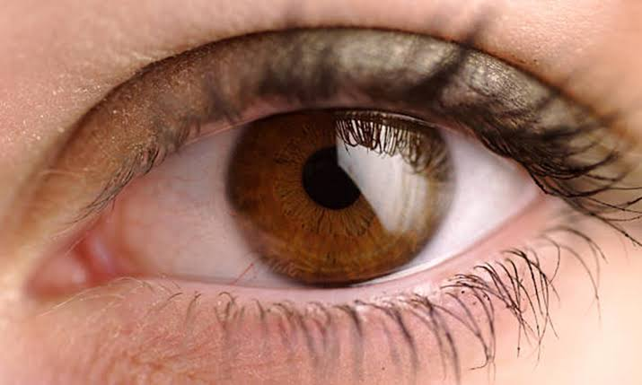

Slide 5
Regardless of the work we do, eye health should be prioritized and adequate steps taken to protect them there off by avoiding various forms of accidents or working in unfavorable environments²
These responsibilities are borne by both the employers and employees as it is a legal and ethical concern, with potential implications for both parties²

Slide 6
Epidemiology
Global studies have shown that over 13 million people live with vision impairment linked to their work²
An estimated 3.5 million workplace eye injuries occur every year. This amounts to 1% of all non-fatal occupational injuries²

Slide 7
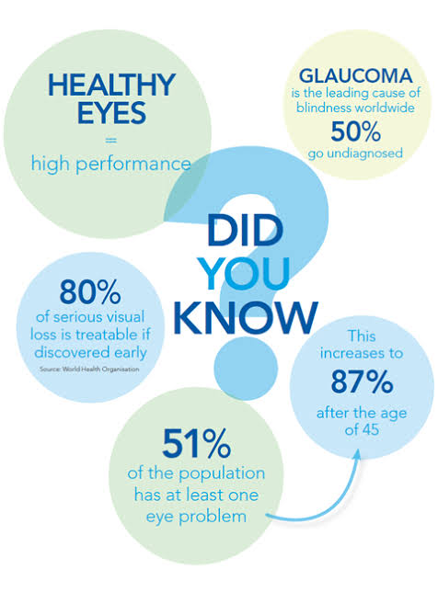

Slide 8
Why Eye Health Matters in Legal Work
The eyes are the lawyer’s “tools of trade”
Most of the work involves reading for extended periods of time, writing and spending long hours on screens
High risk of digital eye strain ( computer vision syndrome)
Hence to ensure optimal productivity and comfort, clear vision is paramount as it ensures accuracy, speed and focus
Poor eye health on the other hand can slow decision-making and increase errors

Slide 9
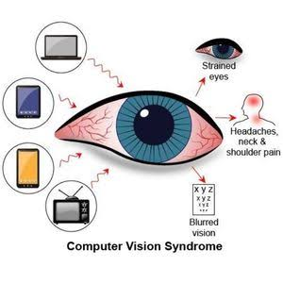
Common Eye Issues in Legal Practice
Dry eyes and irritation
Blurred vision and headaches
Eye fatigue and difficulty focusing
Computer vision syndrome
Increased risk of long-term vision problems
Presbyopia

Slide 10
Risk Factors in the Legal Workplace
Prolonged screen use (laptops, Tablets, phones)
Poor lighting or glare in offices, courtrooms, etc
Incorrect posture or screen positioning
Infrequent eye exams
Skipping breaks
Forgetting to blink

Slide 11
Impact on Judicial Efficiency
Visual fatigue reduces reading speed and comprehension
Eye discomfort leads to distraction and reduced output
Missed signs of eye diseases can lead to permanent vision loss e.g. glaucoma

Slide 12
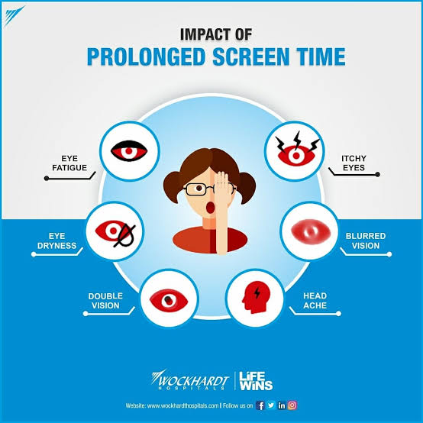

Slide 13
Prevention
Take regular breaks
Follow the 20-20-20 rule
Use antiglare screens, lenses
Adjust screen brightness and contrast
Ensure proper lighting in intensity and position
Maintain ergonomic work station
Stay hydrated – reduces dryness
Use preservative-free artificial tears if needed
Eat healthy, exercise
Schedule eye examinatins with an eye specialist

Slide 14
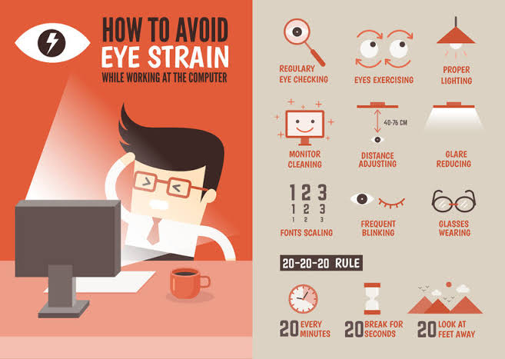

Slide 15
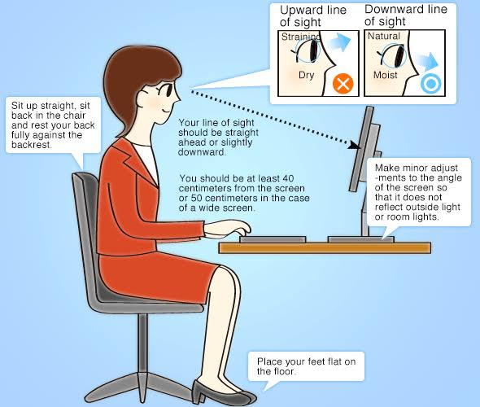
Innovation for Eye wellness
Blue light filtering software- LED devices
Ergonomic office set up
Screen time trackers
Specialised glasses for digital workers

Slide 16
When to see the Eye Doctor
Blurred or fluctuating vision
Frequent headaches
Eye pain or dryness
Difficulty reading small prints
Family history of eye disease - glaucoma

Slide 17
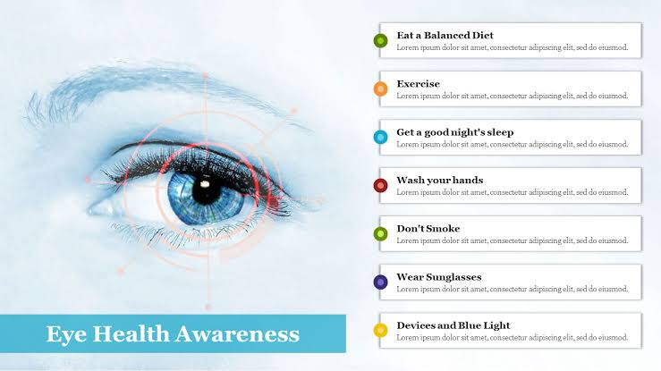
Tips to ensure Eye Health

Slide 18
Conclusion
Eye health is an integral part of legal productivity
Small adjustments can lead to clearer vision and sharper minds with better productivity
Protect your eyes, protect your work
Picture credits – internet.

Slide 19
References
1. Ramke, J, Ah Tong, B. A., Faal, H. B., & Burton, M. J. (2021). Defining eye health for everyone. Ophthalmic & physiological Optics: The Journal of the British College of Ophthalmic Opticians (Optometrists)
International Labour Organisation – Eye Health and the World of Work ISBN 9789220395578 (web PDF)
Eye Health- Eye Wiki
NPMCN Optics Course update materials.

Slide 20
Thank you for listening!
Any Questions?

