Slide 1
HEALTH AND WELLNESS : MANAGING AGE RELATED ILLNESSES AND MUSCULOSKELETAL DISORDERS
PROF. K. MADU. MBBS,FMCS,FWACS,FMCOrtho.
CHIEF CONSULTANT ORTHOPAEDIC SURGEON

Slide 2
Introduction
“Judges, being flesh and blood, are subject to the same emotions and human frailties as affect other members of the species.” Hon. Thomas B. Finan, in his opinion in State v. Hutchinson.
Very necessary and emerging judicial contribution.
Clarity and focus for sound decision making.
Positive work environment and improved job satisfaction
Ensures longevity and wellness on the bench
Supportive and inclusive culture within the judicial system

Slide 3
Illnesses and musculoskeletal disorders
Age-related Illnesses
  Hypertension.
  Diabetes.
  Cardiovascular diseases.
  Depression, stress, burnout.
  Malignancies.
    Prostate/Breast cancers
Musculoskeletal Disorders
  Chronic back and neck pain/Degenerative spine disease.
  Arthritis/Joint pain.
  Carpal tunnel syndrome.

Slide 4
IMPACT ON JUDICIAL PERFORMANCE
Concentration and cognitive function
Limitations of mobility
Pain and discomfort
  Impair judgment/decision-making abilities
  Also impairs emotional intelligence.
Chronic health issues
  Absenteeism
  Decreased productivity
  Increased mortality.

Slide 5
Prevention Strategies
Regular exercise and physical activity to prevent musculoskeletal disorders.
Healthy eating habits
Regular medical check-ups for early detection and management of age-related diseases.
Medication compliance.
Ergonomic workspaces and equipment to reduce strain and prevent disorders.
Emotional regulation techniques to promote overall well-being

Slide 6
Psychology of anger: causes and consequences on adjudication.
A natural human emotion with a spectrum and effects
Anger has been shown to be related to punitiveness.
Triggers can be external or internal (underlying issues).
Our cognitive interpretation of situations stimulates our reactions.
The judicial importance of anger and punitiveness lies in the subjective nature of determining criminal intent.

Slide 7
Consequences of anger on adjudication
Overly punitive judgements and attributions of causality.
Clouds judgement and impairs decision making
Impulsive behavior.
Bullying
Poor depth processing
Lack of reflection
Anger release hormones that lead to physical health challenges.
Depression, anxiety and low self esteem.

Slide 8
Strategies for managing anger
Identify and be aware of the triggers.
Feel the anger without judgement, pause and reflect on it.
Coping techniques like mindfulness, grounding, breathing exercise.
Situational changes.
Communicate clearly and assertively.
Shift to and focus on solutions.
Set clear boundaries.

Slide 9
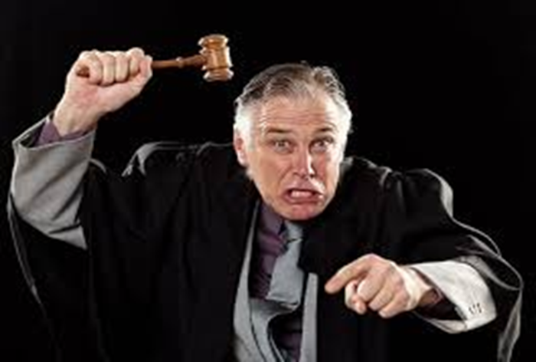
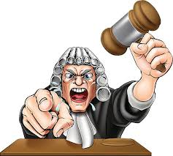
Anger management: Judicial self-regulating practices

Slide 10
Anger management: Judicial self-regulating practices
in 1651, Thomas Hobbes declared that the ideal judge is “divested of all fear, anger, hatred, love, and compassion.
judicial dispassion to be a “fundamental tenet of Western jurisprudence.”
“We’re not robots [who] listen to evidence and don’t have feelings. We have to recognize those feelings and put them aside.” Hon. Sonia Sotomayor, testifying before the U.S. Senate Judiciary Committee.
“Seeing absolute misery passing in front of you day in, day out, month in, month out, year in, year out.
The Scylla of too much emotion and the Charybdis of no “feeling for humanity” at all
Hochschild’s concept of emotional labor

Slide 11
Anger management: Judicial self-regulating practices
Emotional regulation can be harmful if poorly deployed.
Emotional suppression is bad for judging and for the judge.
A good judge is a good emotional regulator, but how to do this?
Is anger good or bad for a judge?
The concept of well-regulated anger: righteous anger and a virtuous judge.
Aristotle’s concept of virtue; is your anger at the right person, for the right reason and in the right manner.
Anger triggers: family, staff, lawyers, court room behavior ,etc.

Slide 12
Strategies for regulating anger and emotions
Recognize the emotion and engage appropriate emotion regulating techniques
Avoidance techniques may be helpful, but not always possible.
Repression and denial lead to poor psychological and health outcomes.
Behavioral suppression is sometimes necessary but ineffective.
Practice mindfulness (deep listening to the parties before the court, reflection, the regulation of emotion, empathy, compassion).
Cognitive reappraisal/self reflection techniques are beneficial
Judicial disclosure is helpful (selected talking and journalling).
The emotionally intelligent judge is the target.

Slide 13
Medical care and judicial wellness
Judicial wellness is a concept encompassing physical and mental wellness.
Judicial well being leads to high quality justice delivery.
The Nauru declaration on judicial well being (with UNODC) recognizes judicial pressures, stress, workloads, burnout, etc.
76% of judges do not have sufficient time to maintain optimal physical and mental well-being.
Systemic isolation is inherent in going from lawyer to judge.
“The most important asset for a court is a healthy judge,”.

Slide 14
Judicial wellness strategies
Raising awareness and reducing stigma.
“Standing at the bench”.
Practice humor.
Proper nutrition leads to better stress management.
Be sure to sleep well
Combat vicarious trauma with emotional regulation practices. Seek help if necessary.
Practice mindfulness ( yoga, breathing exercises, meditation,)
Regular exercises is helpful.

Slide 15
Conclusion
Age-related illnesses and musculoskeletal disorders can significantly impact a judge’s physical and mental capabilities.
Maintaining judicial health and wellness is crucial for judges to perform effectively and make sound decisions.
Proactive measures such as emotional regulation, regular exercise, healthy eating, and ergonomic workspaces are essential for preventing these health issues.
Supporting judges with stress management techniques and mental health resources can enhance their overall well-being
Prioritizing the health and wellness of judges not only benefits the individuals but also ensures a fair and efficient judicial system for all.

Slide 16
Suggested reading
Judicial wellness. National Judicial Task Force to examine state courts’ response to mental illness.
The Emotionally Intelligent Judge: A New (and Realistic) Ideal by Terry .A. Maroney.
Judicial Perspectives on Emotion, Emotion Management, and Judicial Excellence in the USA by Elek. J.
Emotional regulation and judicial behavior by Terry Maroney

